Slide 1
Analysis of Numerical Root-finding methods
Carl De Vries Calculus II – Honors - 2013

Slide 2
Introduction
Objectives
Background
Understand the theory behind four fundamental methods:
Bisection method
False Position method
Newton-Raphson method
Secant method
Address termination criteria.
Validate our code.
Applications of numerical methods
Actuarial sciences
Plotting spacecraft trajectories
Calculating the values of financial instruments
Notes:
Analytical methods
Polynomial Inequalities, Quadratic Equation, Graphing
Numerical Methods
Definition – algorithm, iterative, arithmetic operations, initial guess
Initial guesses made using previous knowledge, graph, etc

Slide 3
Background
Find the x values where f(x) = 0.
Initial guesses and bounds are made by graphing the solution.
Methods are divided into two families.
Bracketing methods
Open methods

Slide 4
Bracketing methods
Bracketing methods require both an upper bound and a lower bound.
Decrease the width of the interval [x_{l},x_{u}] around the root.
Find the interval containing the root after each iteration.
Bracketing methods always converge.
Notes:
Require an upper and lower bound which “bracket” the root
decrease the interval between the bounds until we reach an answer that is accurate enough
With bracketing methods, we want to
1. find an approximation
2.determine the interval containing the true root
3. repeat using the new interval

Slide 5
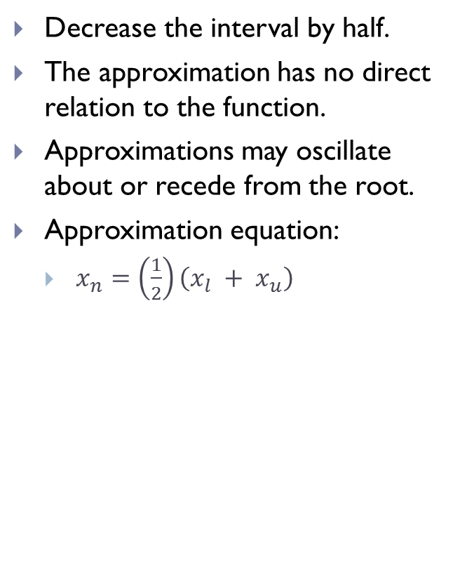
Bisection method
Decrease the interval by half.
The approximation has no direct relation to the function.
Approximations may oscillate about or recede from the root.
Approximation equation:
$x_{n}=\left(\frac{1}{2}\right)\left(x_{l} + x_{u}\right)$
Notes:
Choose your bounds
Find the mid point

Slide 6
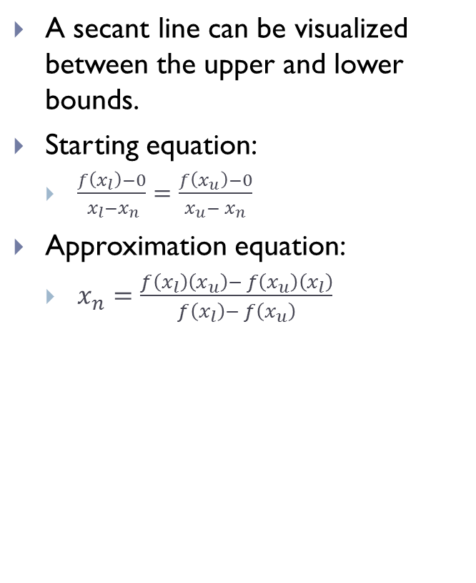
False Position method
A secant line can be visualized between the upper and lower bounds.
Starting equation:
$\frac{f\left(x_{l}\right)−0}{{ x}_{l}−x_{n}}=\frac{f\left(x_{u}\right)−0}{x_{u}− x_{n}}$
Approximation equation:
$x_{n}=\frac{f\left(x_{l}\right)\left(x_{u}\right)− f\left(x_{u}\right)\left(x_{l}\right)}{f\left(x_{l}\right)− f\left(x_{u}\right)}$
Notes:
The bounds start the same distance away from the true root.
The approximation will tend to be closer to the bound with a lower value for f(x)

Slide 7
Open Methods
Open methods may only require a single initial guess.
The initial guesses aren’t required to surround the root.
Open methods tend to converge faster than bracketing methods.
The approximations may diverge from the root.

Slide 8
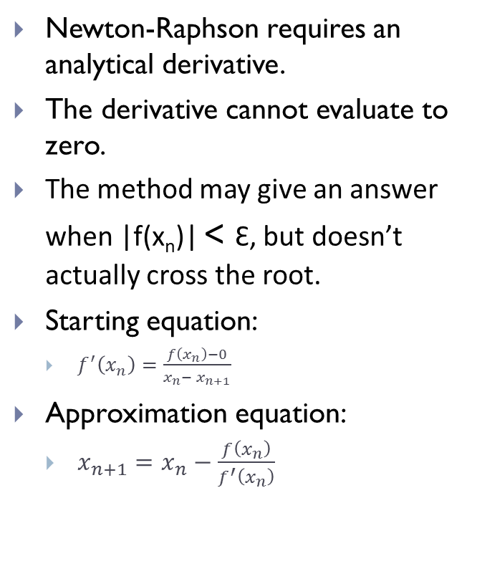
Newton-Raphson method
Newton-Raphson requires an analytical derivative.
The derivative cannot evaluate to zero.
The method may give an answer when |f(x_{n})| < Ɛ, but doesn’t actually cross the root.
Starting equation:
$f^{′}\left(x_{n}\right)=\frac{f\left(x_{n}\right)−0}{x_{n}− x_{n+1}}$
Approximation equation:
$x_{n+1}=x_{n}−\frac{f\left(x_{n}\right)}{f^{′}\left(x_{n}\right)}$
Notes:
Analytical derivative makes Newton-Raphson unrealistic for some functions.
Demonstrate why slopes close to zero are poor choices x=1, y=2.8, m= small number, xn+1 = extremely large number

Slide 9
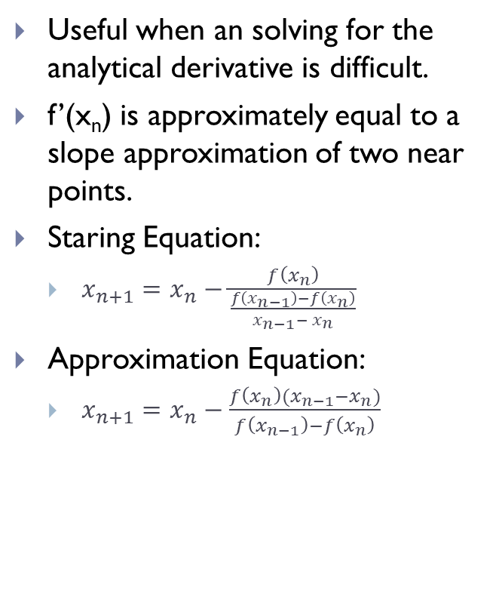
Secant method
Useful when an solving for the analytical derivative is difficult.
f’(x_{n}) is approximately equal to a slope approximation of two near points.
Staring Equation:
$x_{n+1}=x_{n}−\frac{f\left(x_{n}\right)}{\frac{f\left(x_{n−1}\right)−f\left(x_{n}\right)}{x_{n−1}− x_{n}}}$
Approximation Equation:
$x_{n+1}=x_{n}−\frac{f\left(x_{n}\right){(x}_{n−1}−x_{n})}{f\left(x_{n−1}\right)−f\left(x_{n}\right)}$

Slide 10
Divergence
Open method approximations may diverge from the root completely.
If multiple roots exist, the approximation may converge on a different root.
Example using Newton-Raphson
Roots at
x = -0.419
x = 0.388
x = 1.230
f(x)
f(x) = -5x³+6x²+x-1
x
Notes:
With NR x₃ = 1.300

Slide 11
Stopping Criteria
Determine when the approximation is accurate enough.
Truncation error
Round-off error
Maximum Iterations
Epsilon is too small
The approximation diverges
Poor initial guess

Slide 12
Stopping Criteria
Option one
Option two
|f(x_{n})|< Ɛ
|f(x_{n})| < Ɛ_{v} and x_{u} - x_{l} < Ɛ_{h}
Ɛ_{v} is a vertical measure
Ɛ_{h} is a horizontal measure
The Δx < Ɛ condition is useful for functions which approach the x-axis asymptotically.
f(x)
f(x)= 1/x
f(x) = 0.1
x
Notes:
E_{v} – vertical measure
E_{h} – horizontal measure
Y=(1/x) -0.01
X_{r} = 100 – set y to 0 and solve for x or plug in 100 for x
Bi – Option 1 E = 0.01
L = 25 and u = 150
X₁ = 87.5
Bi – Option 2 E_{v} = 0.01 and E_{h} = 0.1
L = 25 and u = 150
X₁₂ = 99.98
Make the determination when you sketch the graph for initial bounds

Slide 13
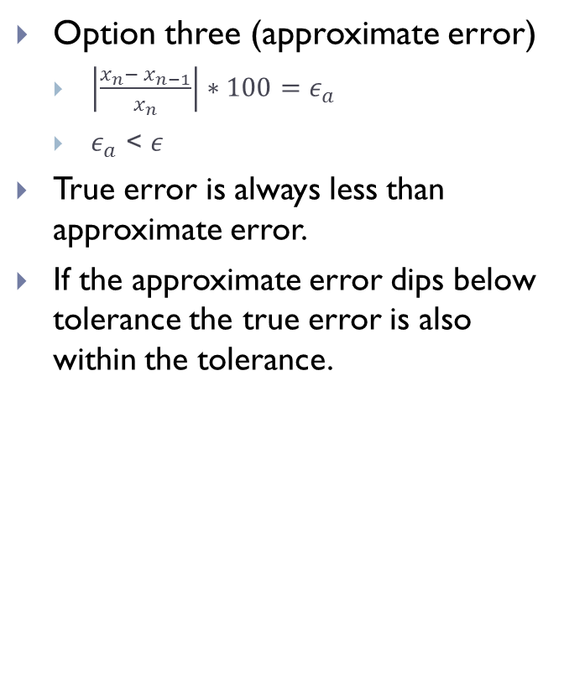
Stopping Criteria
Option three (approximate error)
$\left|\frac{x_{n}− x_{n−1}}{x_{n}}\right|∗100=ε_{a}$
$ε_{a}$ < $ε$
True error is always less than approximate error.
If the approximate error dips below tolerance the true error is also within the tolerance.
Notes:
Use approximate error because to calculate true error we would need the true root, thus no need for the numerical method
X_{n} is assumed to be theoretical value because it should be more accurate
Graph data comes from Bisection on x²+x-30
Fun fact: the approximate error for every iteration of NR where f(x) = 1/x is 50%

Slide 14

Code Validation
Known solution
Variables
Equation: x²+x-30 = 0
(x+6)(x-5) = 0
Roots at x = -6 and x = 5
Stopping criteria three
$ε$= 0.01%
Max Iterations = 20
Method | x_{l} | X_{u} | i | x_{n}
Bisection | 2 | 7 | 14 | 5.000183105
False Position | 2 | 7 | 6 | 4.999945306
 | x_{n} | x_{n+1}
Newton-Raphson | 2 | N/A | 5 | 5
Secant | 6 | 7 | 4 | 5.000000161

Slide 15
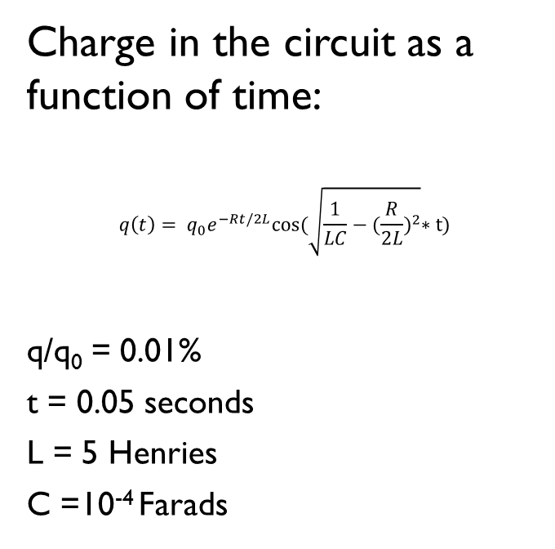
Code Validation
Case Study
Equation
When a circuit changes state, the energy storage in capacitors and inductors oscillates.
Find the resistance required to dissipate the fluctuations in charge.
Use Bisection method
Determined initial bounds by graphing the equation
Charge in the circuit as a function of time:
$$q\left(t\right)= q_{0}e^{−Rt/2L}cos(\sqrt{\frac{1}{LC}−{(\frac{R}{2L})}^{2}}∗t)$$
q/q₀ = 0.01%
t = 0.05 seconds
L = 5 Henries
C =10⁻⁴ Farads
Notes:
Draw the oscillating graph.
Explain the figure looks like cos(x)
Explain that e^{-x} is a coefficient and goes to zero

Slide 16

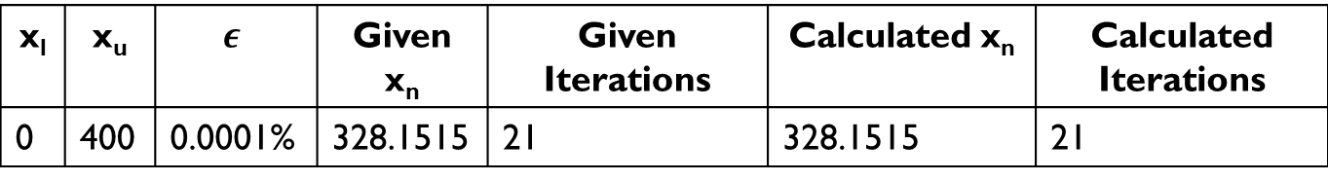
Code Validation
The function rearranged in terms of resistance:
$$f\left(R\right)=e^{−0.005R}\cos\left(\sqrt{2000−0.01R^{2}}\left(0.05\right)\right)−0.01$$
x_{l} | x_{u} | $$ε$$ | Given x_{n} | Given Iterations | Calculated x_{n} | Calculated Iterations
0 | 400 | 0.0001% | 328.1515 | 21 | 328.1515 | 21

Slide 17
Summary
These methods are fundamental numerical methods.
More advanced methods exist, but have their own pros and cons.
The bracketing methods will always converge.
Open methods may converge faster, but may also fail in several ways if:
f‘(x_{n}) = 0
The approximations diverge or converge on a different root.
Approximate error tends to be the best stopping criteria.

